Slide 1
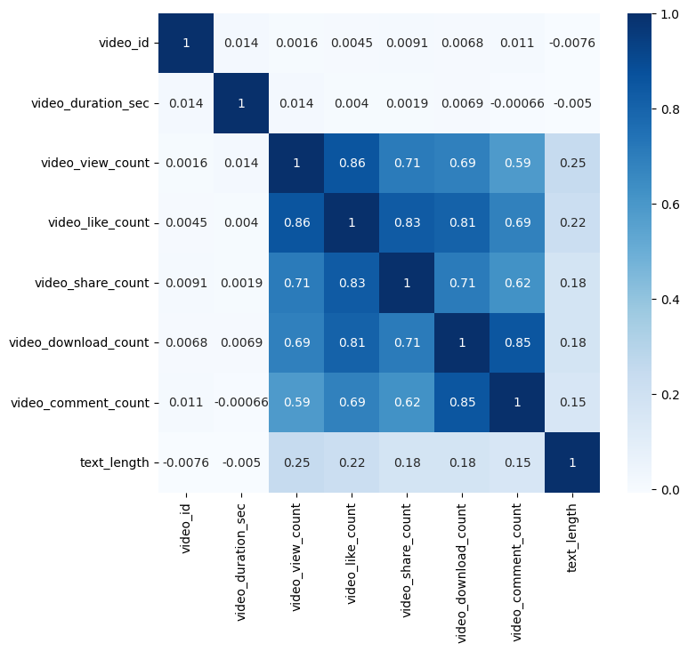
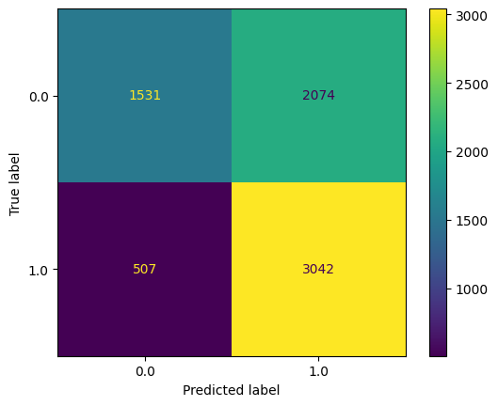
Claims classification project. Logistic Regression
Executive summary report
TikTok is working on the development of a predictive model that can determine whether a video contains a claim or offers an opinion. With a successful prediction model, TikTok can reduce the backlog of user reports and prioritize them more. At this stage of the project TikTok data Team chose to create a logistic regression model, because of the data type and distribution.
The TikTok data team is developing a machine learning model for classifying claims made in videos submitted to the platform.
Exploratory data analysis (EDA) reviled initial information about data.
There were 298 rows with missing values which were removed from the dataset.
No duplicated presented in the data
The number of continuous variabled content outliers.
We reassigned extreme big valued for video_like_count values and set that values as upper limit
Analysis of variables shoed that several variables has correlation between each other and cannot be used together for machine learning model. The TikTok data team chose one of that variables. As we cannot use text variable for
The model had decent predictive power
The longer video and its descriptions tend to be associated with higher odds of the user being verified.
Other video features have small estimated coefficients in the model, so their association with verified status seems to be small.
The next step is to construct a classification model that will predict the status of claims made by users which hopefully will have better performance
model we transform them using OneHotEncoding()
Confusing matrix showed that model performance not really good
Model precision score: 0.59
Model recall score: 0.86
Model accuracy score: 0.64
Model f1-score: 0.70
Upper-left: the number of videos posted by unverified accounts. Upper-right: the number of videos posted by unverified accounts. Lower-left: the number of videos posted by verified accounts. Lower-right: the number of videos posted by verified accounts.

